Slide 1
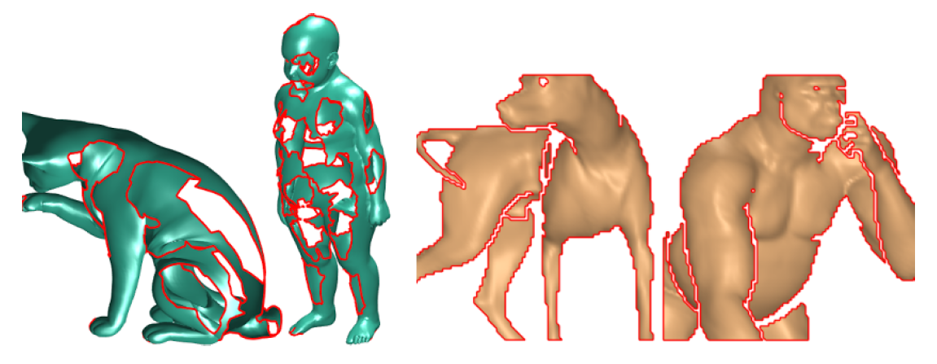
SHREC’17 Track: Deformable Shape Retrieval with Missing Parts
Organizers:
Emanuele Rodolà, Or Litany, Michael Bronstein, Alex Bronstein

Slide 2
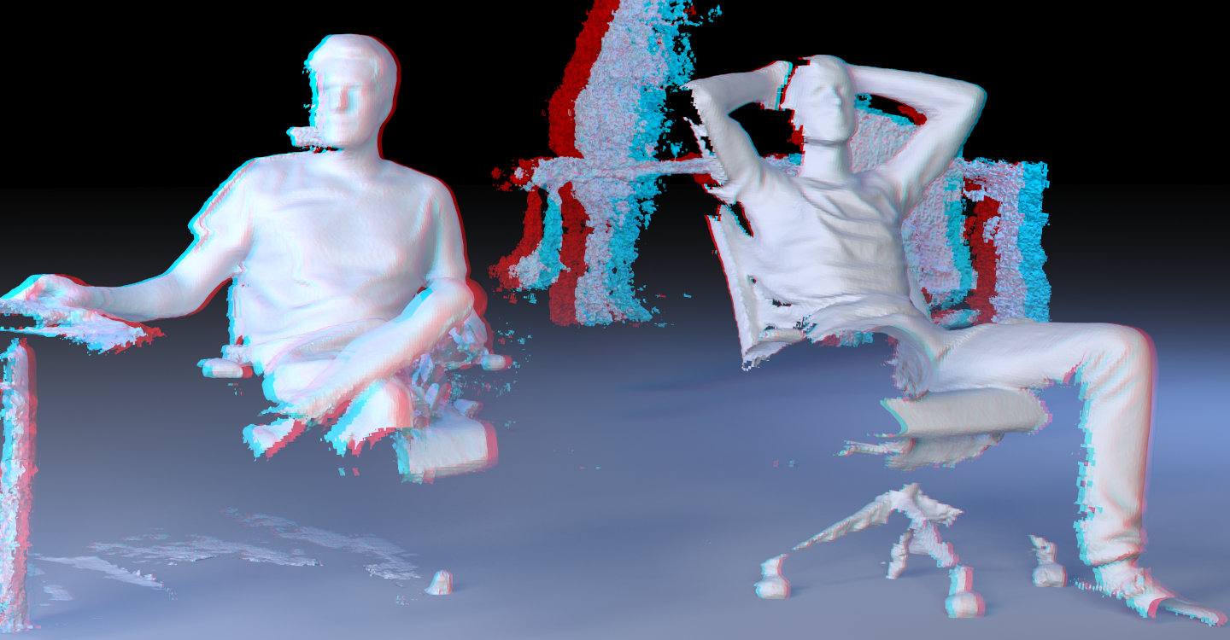
Motivation
Existing retrieval techniques do not deal well with real data, where occlusions and clutter give rise to missing parts and topological noise.

Slide 3
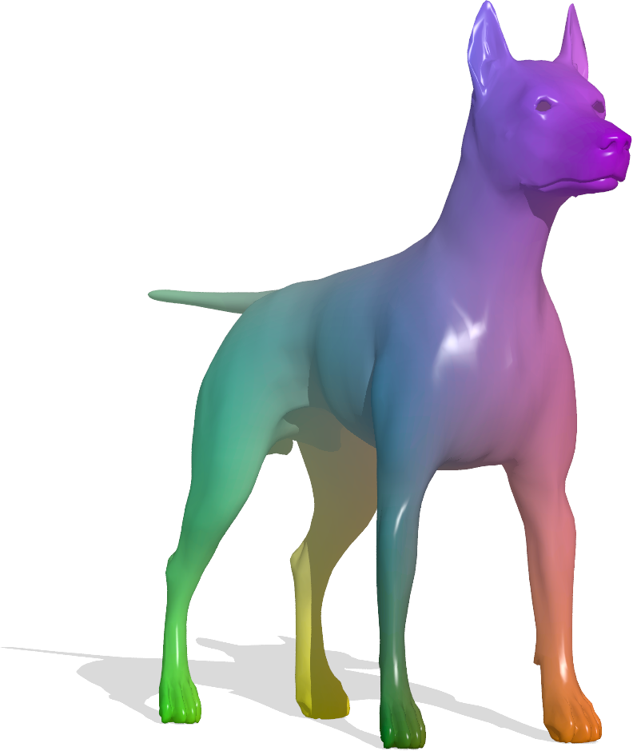
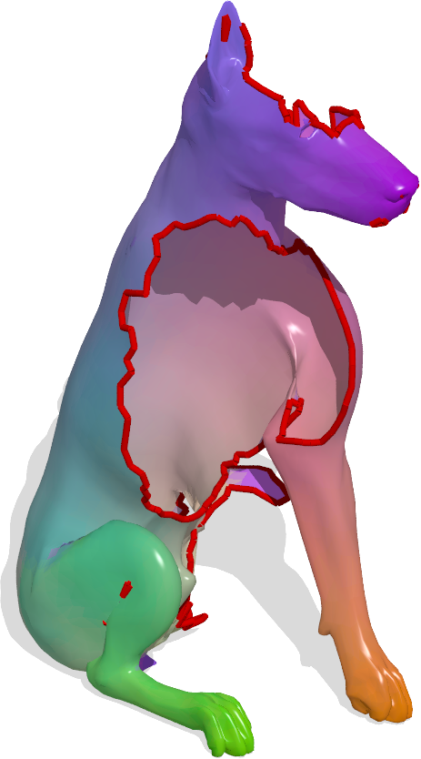
Previous benchmarks
SHREC 2016: Partial Shape Correspondence

Slide 4
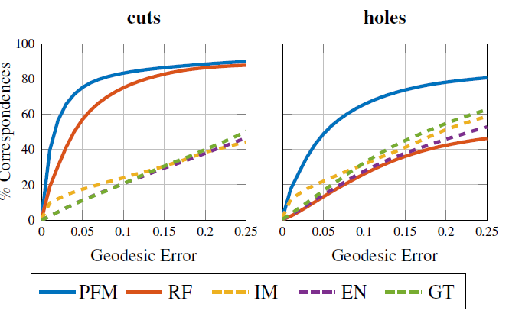
Previous benchmarks
SHREC 2016: Partial Shape Correspondence

Slide 5
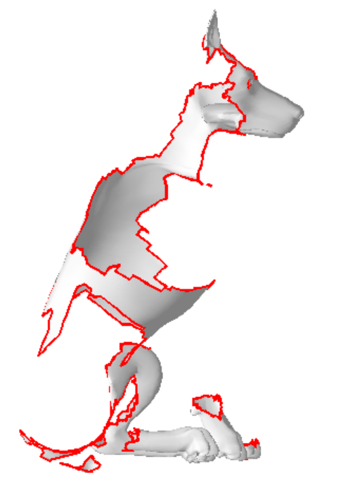
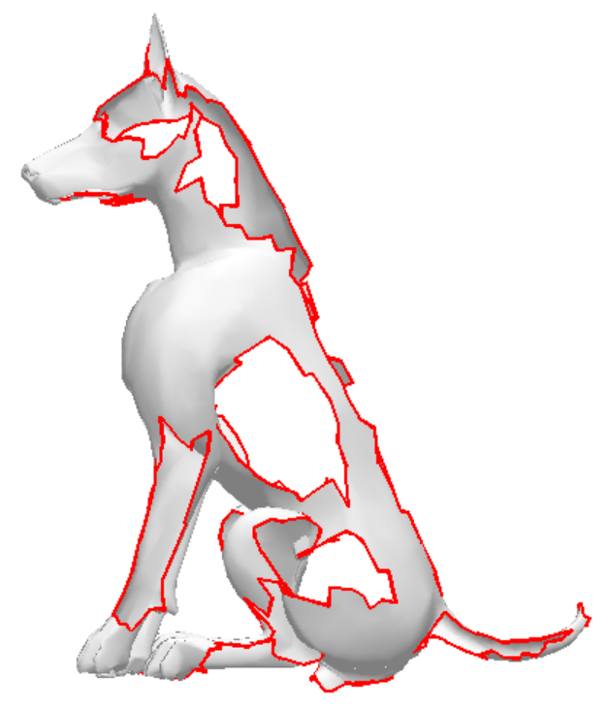
Deformable partial shape retrieval
Query: Deformable model with missing parts
Database: Deformable models with missing parts
partiality

Slide 6
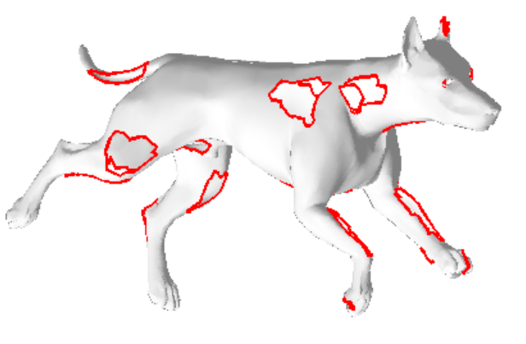
Deformable partial shape retrieval
Query: Deformable model with missing parts
Database: Deformable models with missing parts
partiality + pose change

Slide 7
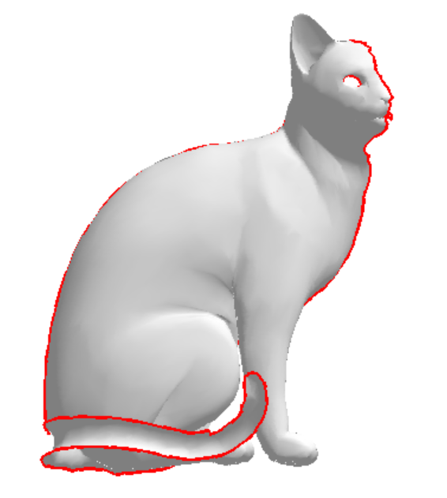
Deformable partial shape retrieval
Query: Deformable model with missing parts
Database: Deformable models with missing parts
different class

Slide 8
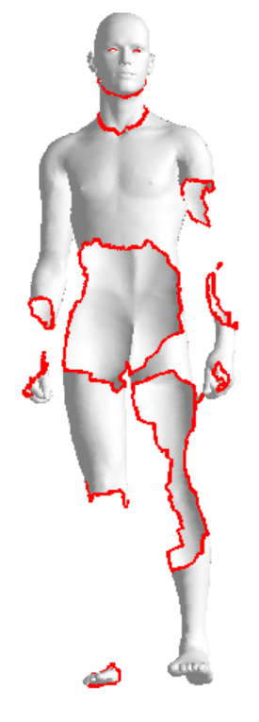
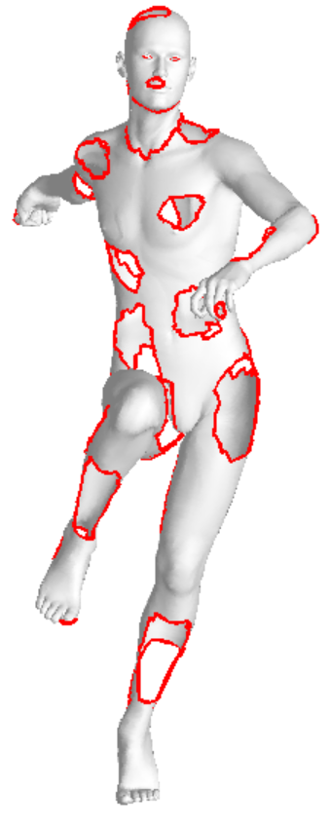
Data noise
We introduced several simultaneous sources of noise:
Change in pose
Missing parts
Disconnected components

Slide 9
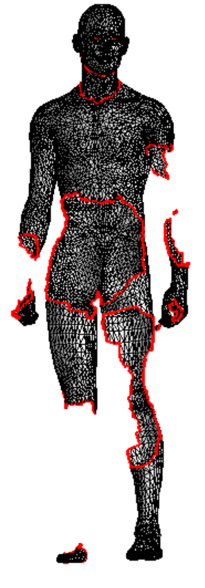
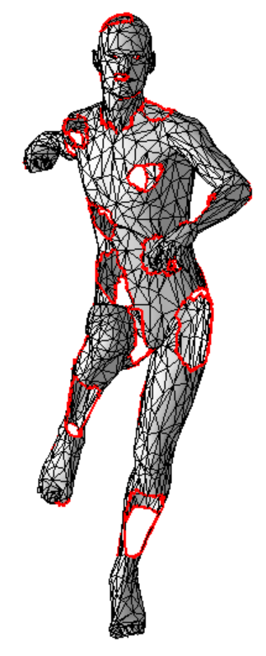
Data noise
We introduced several simultaneous sources of noise:
Change in pose
Missing parts
Disconnected components
Irregular tessellation
Number of vertices/faces

Slide 10
Data noise
We introduced several simultaneous sources of noise:
Change in pose
Missing parts
Disconnected components
Irregular tessellation
Number of vertices/faces
Position in space
Scale

Slide 11
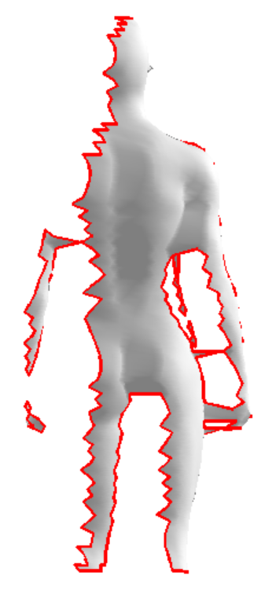
Data noise
We introduced several simultaneous sources of noise:
Change in pose
Missing parts
Disconnected components
Irregular tessellation
Number of vertices/faces
Position in space
Scale
Topological artifacts

Slide 12
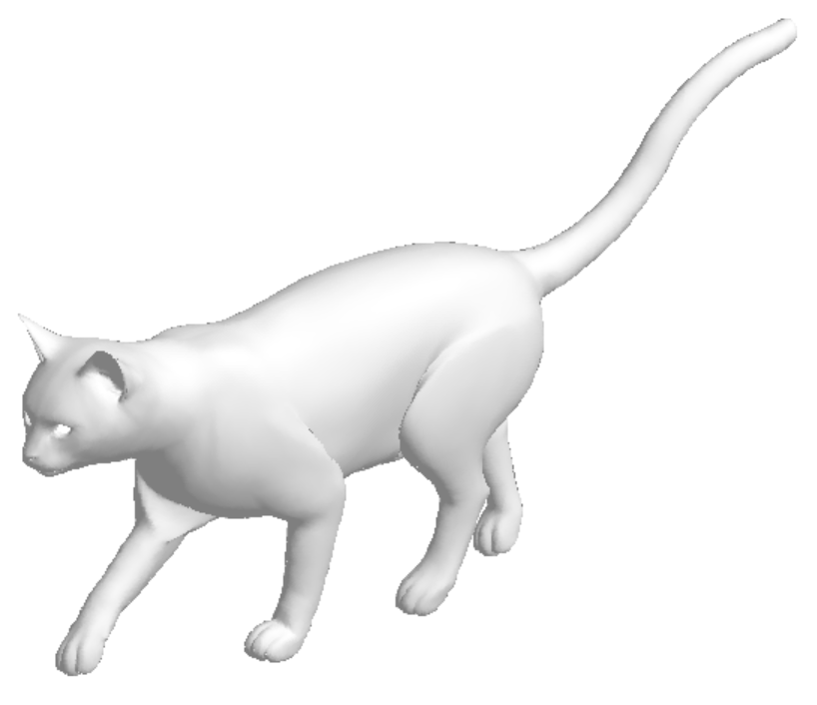
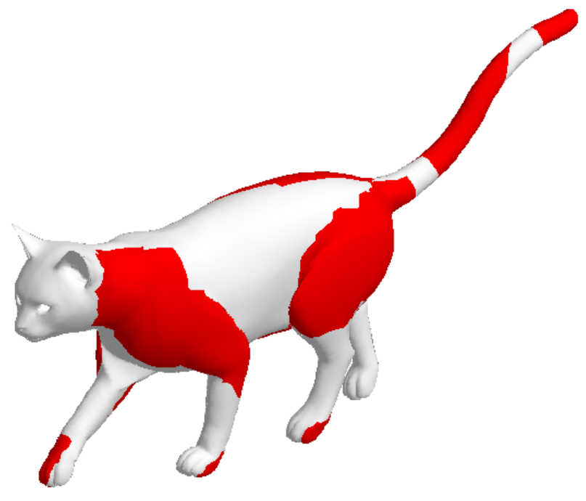
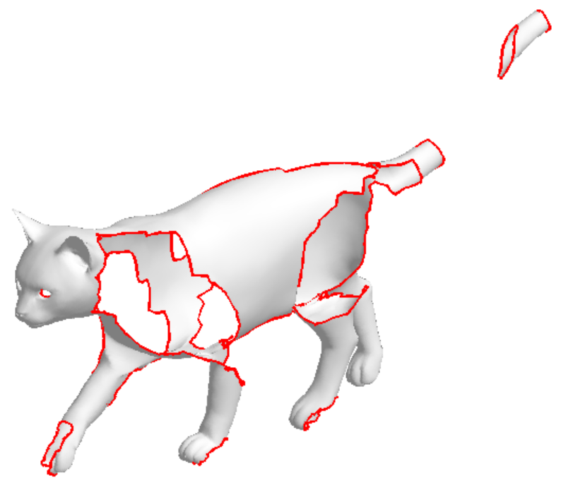
The dataset
We proposed two challenges:
(1) “holes”

Slide 13
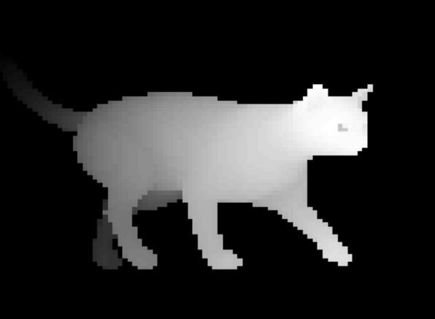
The dataset
We proposed two challenges:
(2) “range”

Slide 14
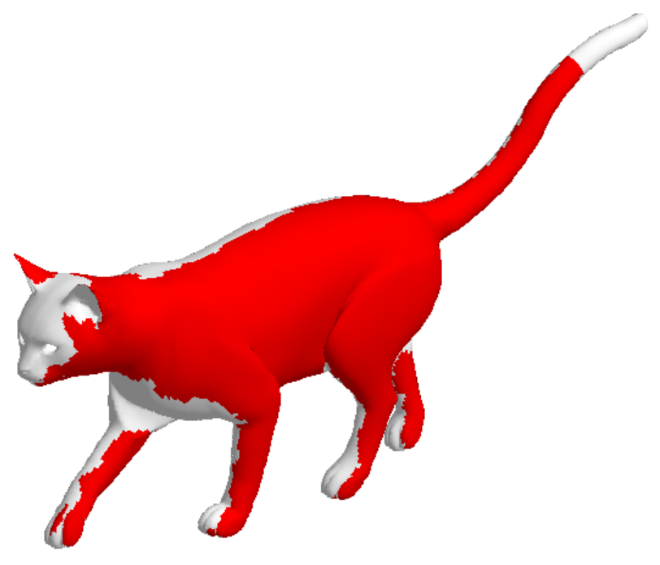
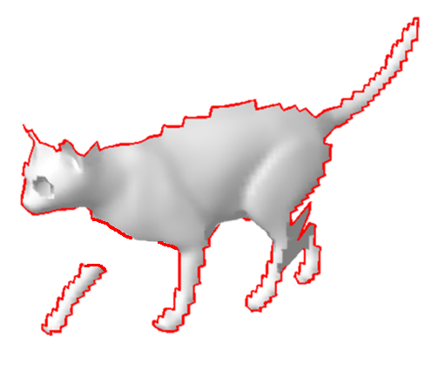
The dataset
We proposed two challenges:
(2) “range”

Slide 15
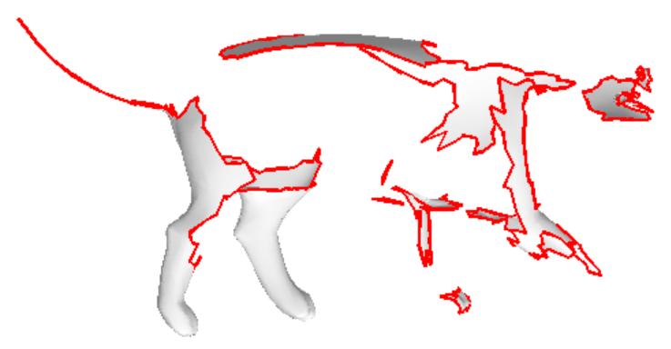
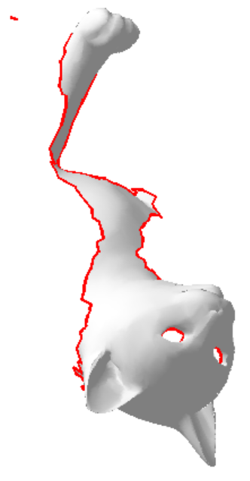
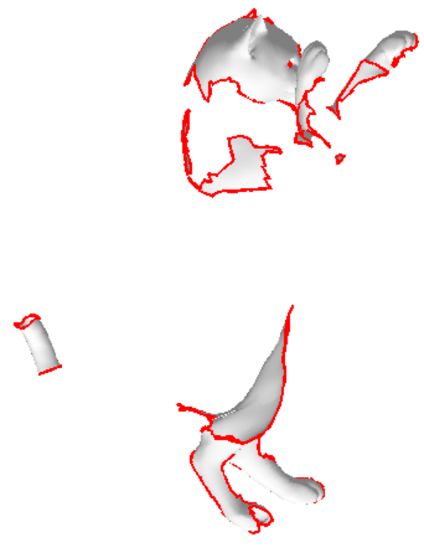
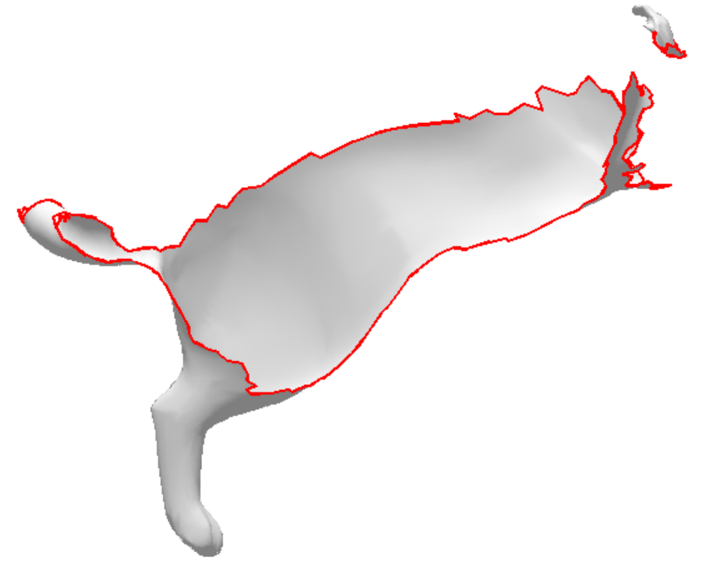
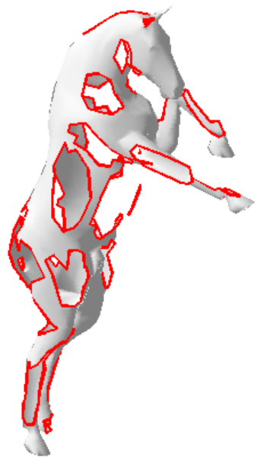
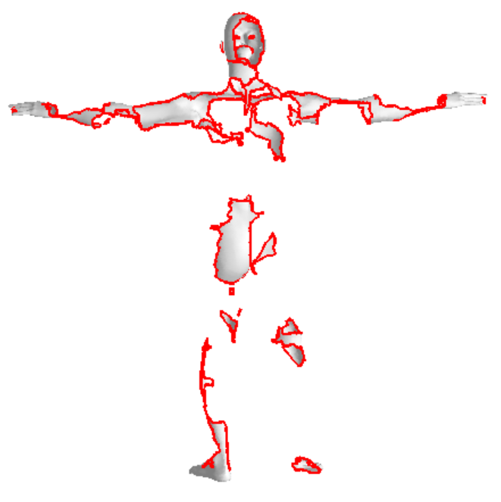
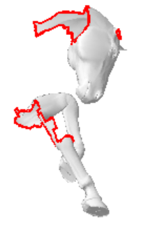
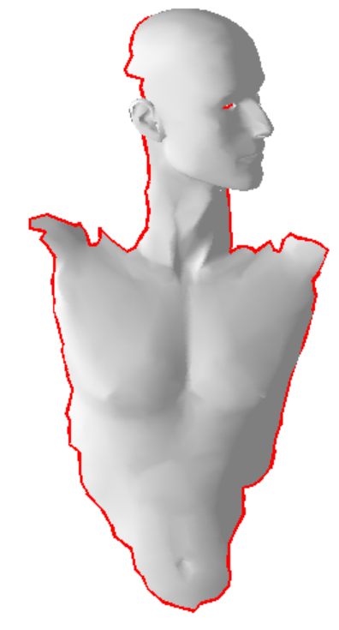
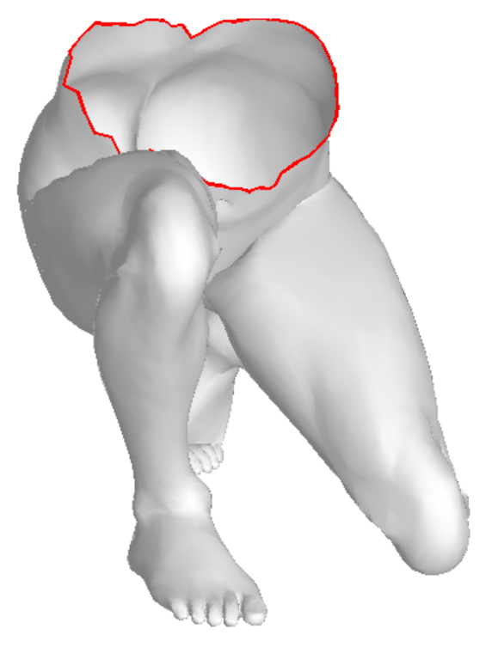
Examples

Slide 16
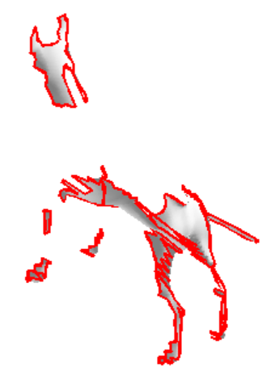
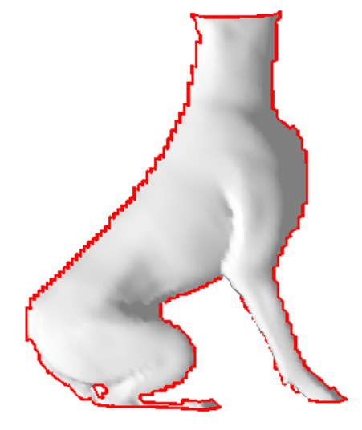
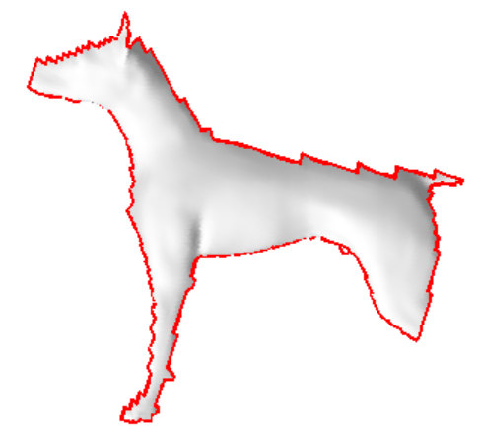
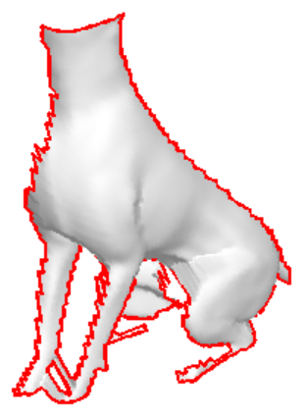
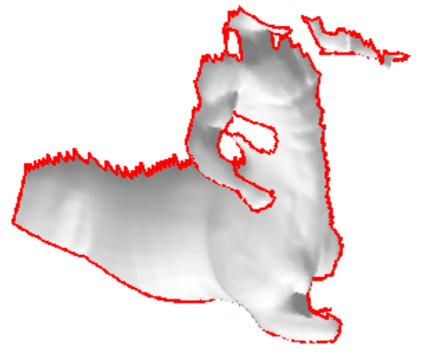
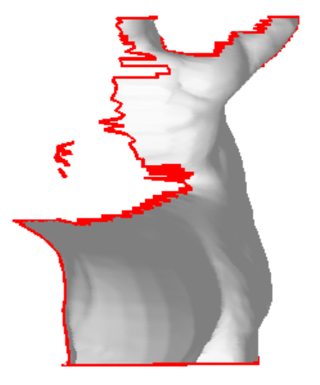
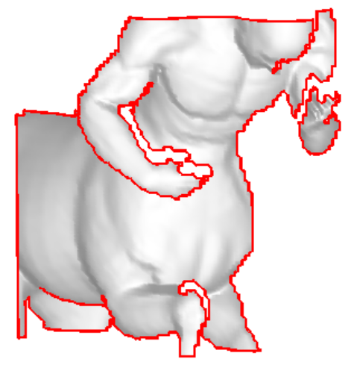
Examples

Slide 17
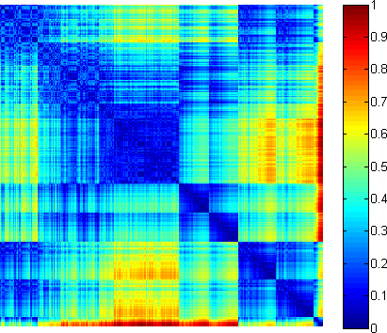
The problem
Shapes are divided into 8 classes (dog, cat, woman, horse, etc.).
Provide a dissimilarity score between every possible pair.
This results in 1078x1078 + 882x882 similarity calculations in total.

Slide 18
Training data
Each challenge comes with a training set, for which category-level ground-truth labels are provided.
Holes: 1216 training shapes
Range: 1082 training shapes
Hindsight: Probably too much training data!

Slide 19
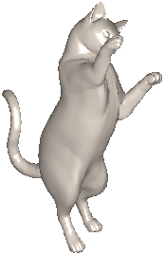
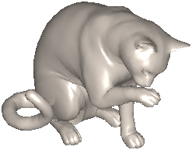
The scale problem
Normalize by total surface area:

Slide 20
The scale problem
These two shapes have the same total surface area:
No obvious scale normalization!

Slide 21
12 methods (8 research groups) + 2 baselines
 | BoW | 2D Views | Other
Supervised | BoW+RoPS SBoF | 2VDI-CNN SnapNet | NPSM RMVM
Unsupervised | GMR SR BoW |  | DNA
Hybrid |  |  | DLSF
 | Spectral | Spatial | Hybrid
Intrinsic | SR NPSM RMVM DNA |  | GMR BoW
Extrinsic |  | DLSF 2VDI-CNN BoW+RoPS SnapNet SBoF

Slide 22
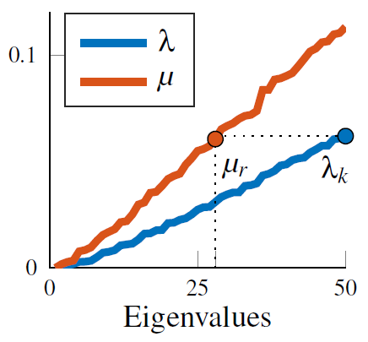
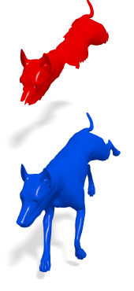
Baseline 1: Partial ShapeDNA
Weyl’s law:
Compare spectra at indices:

Slide 23
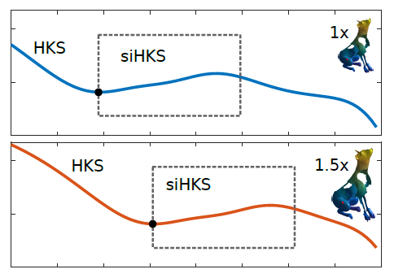
Baseline 2: Bag-of-Words
Scale invariance:
Missing parts:
Compute HKS at small diffusion times using Chebyshev-Padé approx.
[Patané, CAGD 2013]

Slide 24
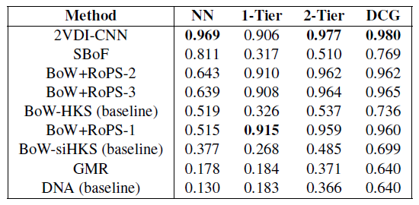
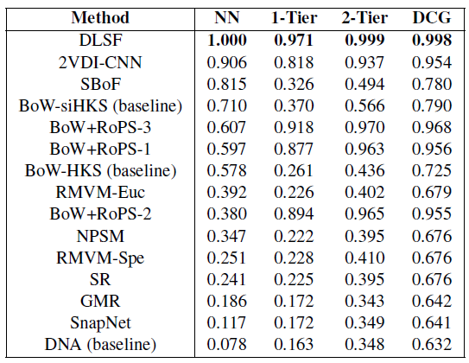
“range”
“holes”

Slide 25
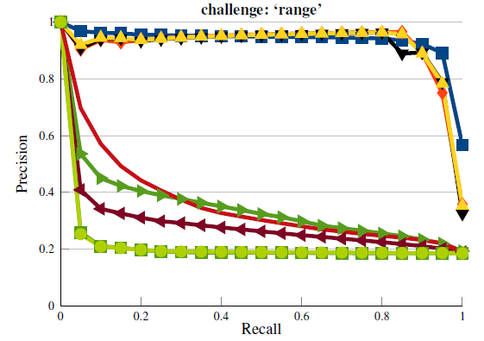
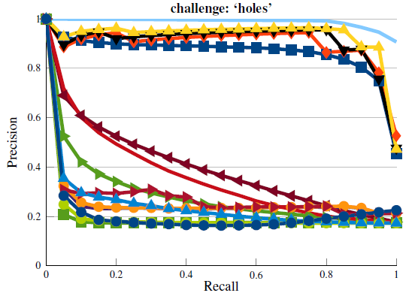
Wide variance both within learning-based and within axiomatic approaches.

Slide 26
Conclusions
Supervised vs. unsupervised: no clear winner
Extrinsic vs. intrinsic: extrinsic seems to perform better
Next challenge: add clutter and multiple instances

